Slide 1

Artefacts and Biases in Gene Set Analysis
Simon Andrews, Laura Biggins, Christel Krueger
simon.andrews@babraham.ac.uk
laura.biggins@babraham.ac.uk
christel.krueger@babraham.ac.uk
V2020-10

Slide 2
What does gene set enrichment test?
Is a functional gene set enriched for genes in my hit list compared to a background set
Are some genes more likely to turn up in the hits for technical reasons?
Are some genes never likely to turn up in the hit list for technical reasons?

Slide 3
Biases
All datasets contain biases
  Technical
  Biological
  Statistical
Biases can lead to incorrect conclusions
We should be trying to spot these
  Some are more obvious than others!

Slide 4
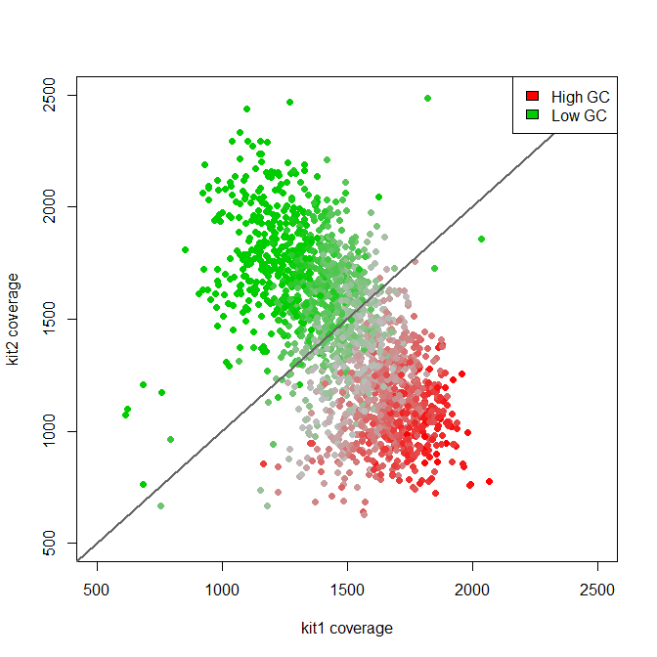
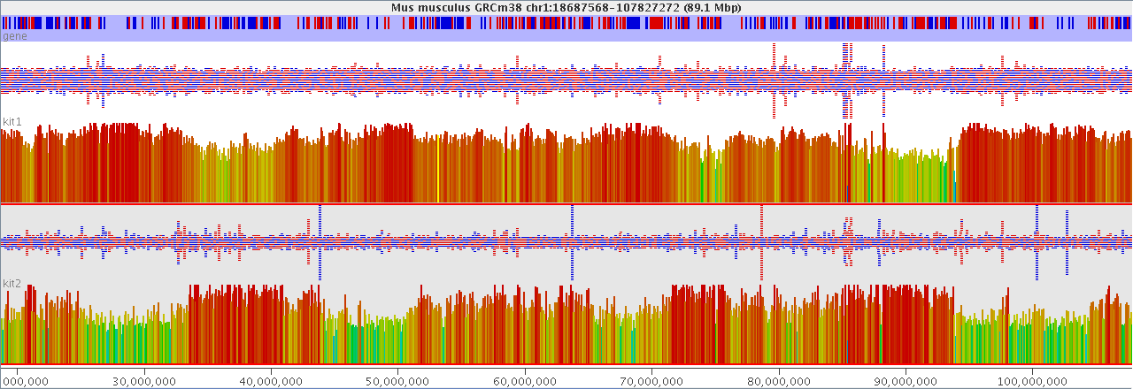
Technical Biases
Simple GC bias from different polymerases in PCR

Slide 5
Statistical Biases
The power to detect a significant effect is based on:
  How big the change is
  How well observed the data is (sample size)
Lists of hits are often biased based on statistical power

Slide 6
RNA-Seq Statistical Biases
What determines whether a gene is identified as
significantly differentially regulated?
  The amount of change (fold change)
  The variability
  How well observed was it
    How much sequencing was done overall?
    How highly expressed was the gene?
    How long was the gene?
    How mappable was the gene?

Slide 7
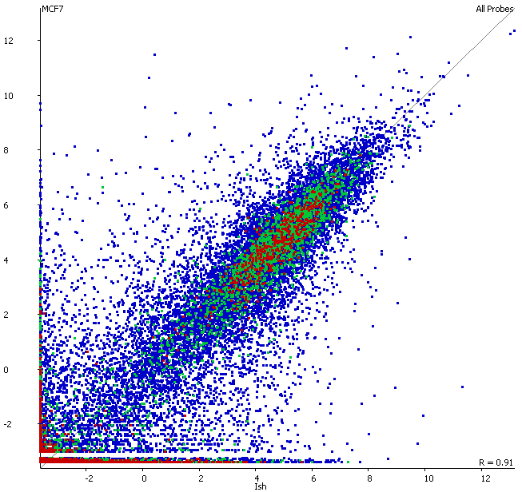
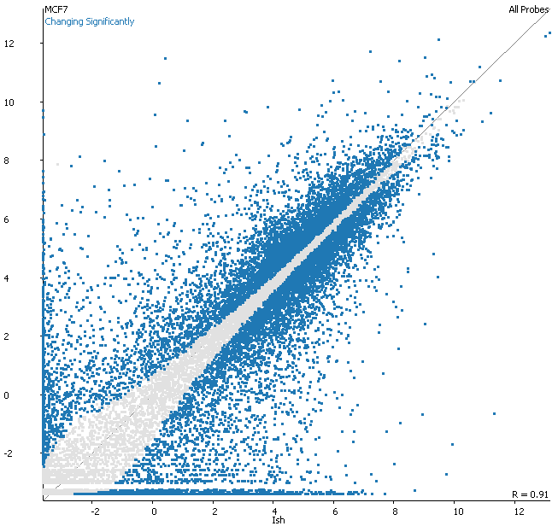
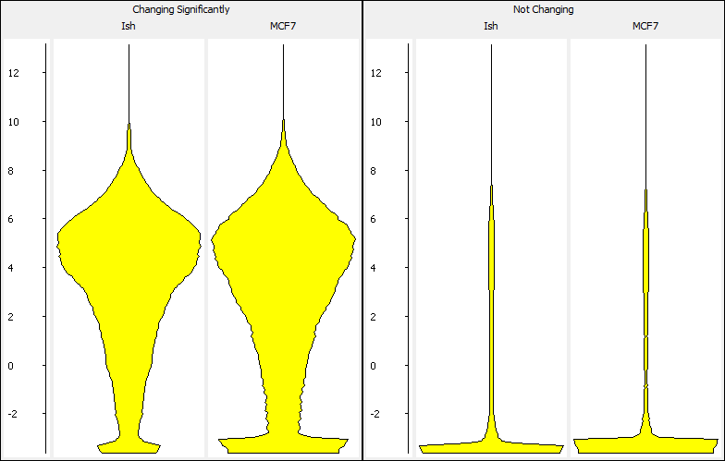
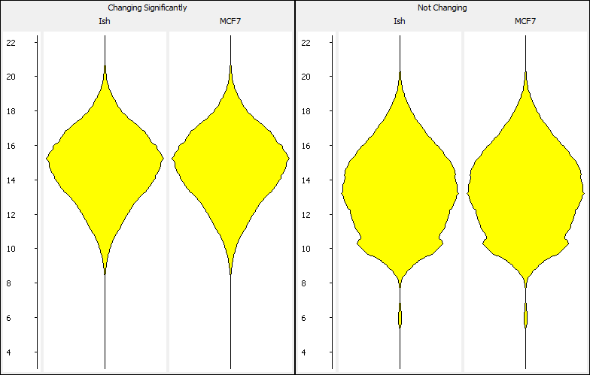
RNA-Seq Statistical Biases
Unlikely to ever see hits from genes which are
  Lowly expressed
  Short

Slide 8
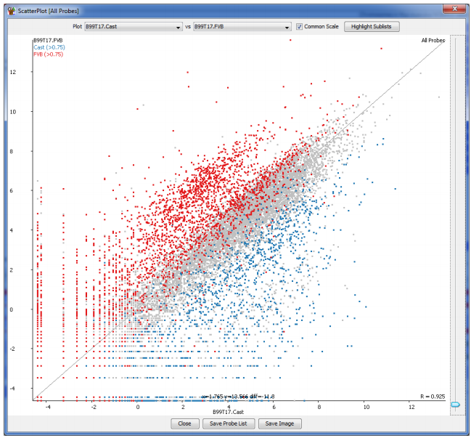
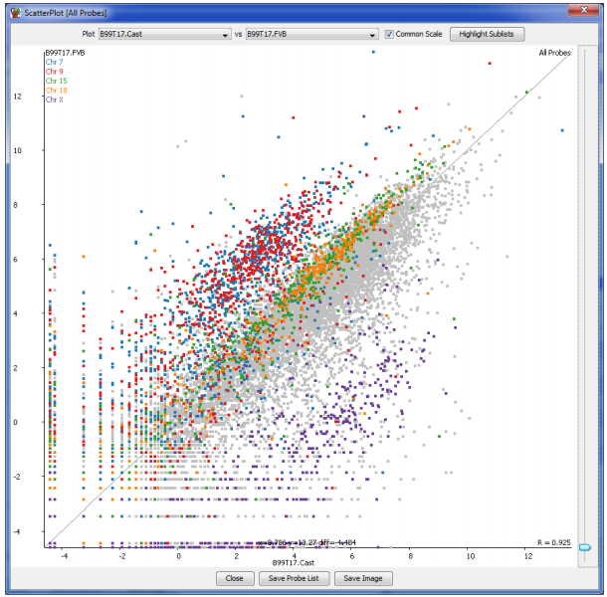
Biological Biases

Slide 9
Biases Look Like Real Biology

Slide 10


Slide 11
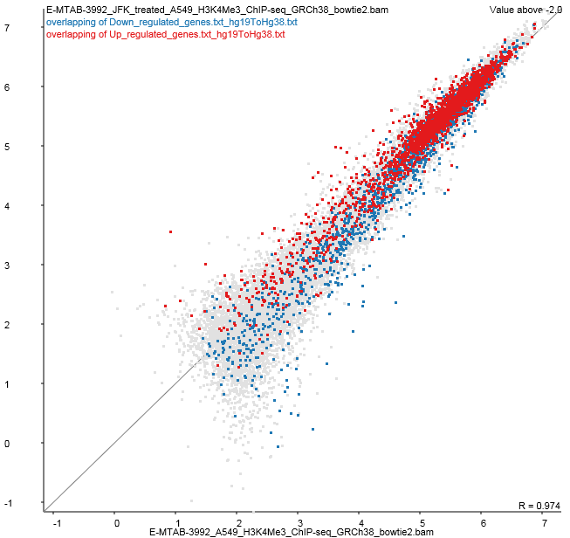
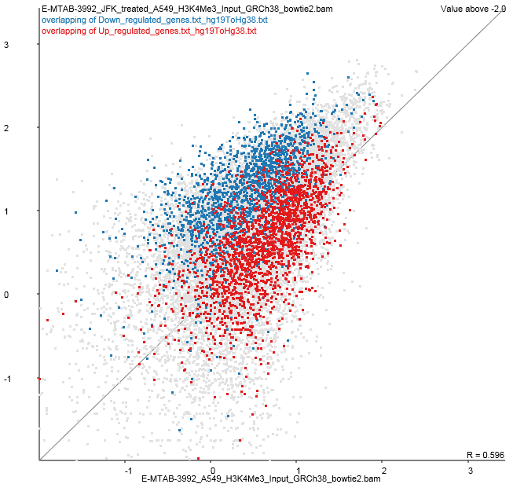
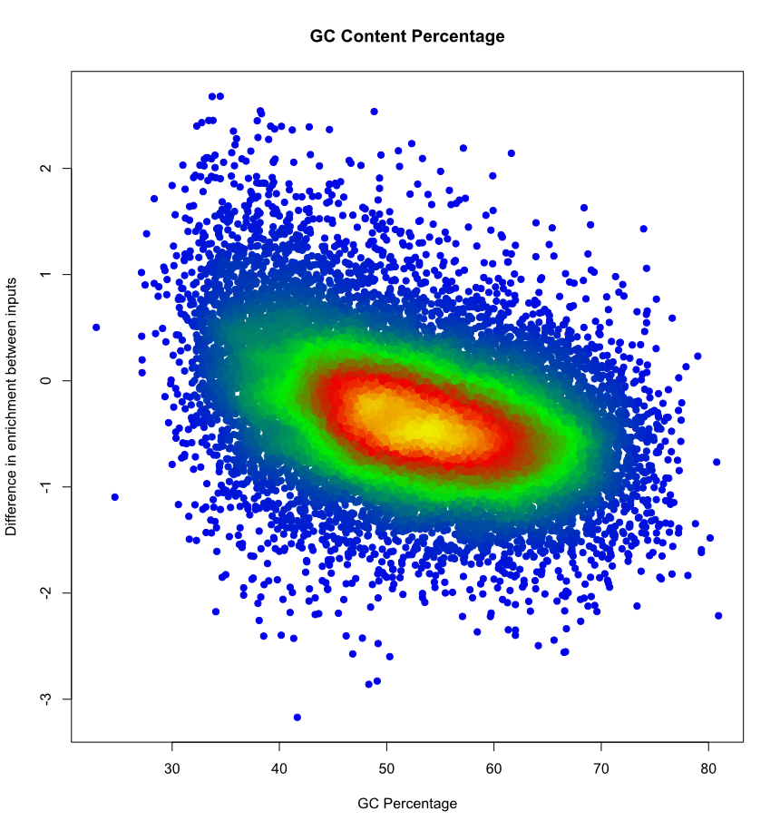

Slide 12
What can you do?
Think about whether you’re likely to have expected biases in your experiment.
  If possible, restructure to avoid the bias
Look for unexpected biases.
  Sometimes the bias is the interesting biology
Use custom backgrounds during Gene Set Analysis to help minimise bias (if a tool supports it)

Slide 13
Correct selection of a background list can make a huge difference
What genes were you likely to see?
  Some are technically impossible
    Membrane proteins in LC-MS
    Small-RNA in RNA-Seq
  Some are much less likely
    Unexpressed or low expressed in RNA-Seq
    Unmappable in ChIP-Seq
    Low CpG content in BS-Seq
Make a list of what you could have seen, and set that as the background.

Slide 14
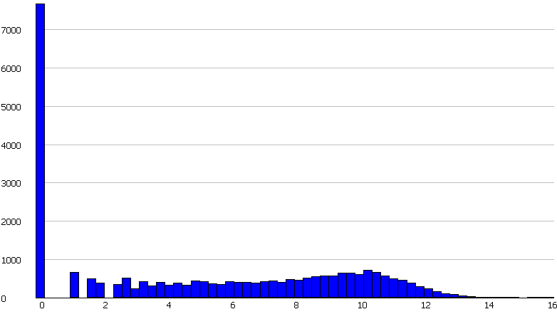
Expressed Genes
Log2 Read Counts per Gene
26,127 Genes Measured

Slide 15
Expressed Genes
<128 (2^7) reads
per gene
Eye Development
(p 8e-4)
Log2 Read Counts per Gene
10,378 Genes Realistically Measured

Slide 16
Statistical biases affect gene sets too
Fisher’s test is powered by
  Magnitude of change
  Observation level
Big lists have more power to detect change
Small lists are very difficult to detect
Some tools allow you to exclude the largest gene set categories. We often use categories with between 50 – 500 genes in to get power and specificity
Always look at the enrichment and the p-value when deciding what is interesting

Slide 17
Fold Change and p-value

Slide 18
Other biases: Relating Hits to Genes
Most functional analysis is done at the gene level
  Gene Ontology
  Pathways
  Interactions
Many hits are not gene based

Slide 19
Other biases: Random Genomic Positions
Find closest gene
  Synapse, Cell Junction, postsynaptic membrane (p=8.9e-12)
  Membrane (p=4.3e-13)
  Glycoprotein (p=1.3e-12)
Find overlapping genes
  Plekstrin homology domain (p=1.8e-7)
  Ion transport (p=7.1e-7)
  ATP-binding (p=3.8e-8)

Slide 20
Other biases: Random Transcripts
Tends to favour genes with more splice variants
  Metal Binding, Zinc Finger (p=4.4e-12)
  Nucleus, Transcription Regulation (p=2.4e-14)

Slide 21
Stuff which turns up more than it should…
Did a trawl through GEO RNA-Seq datasets
  Downloaded pairs of samples which are supposed to be biological replicates
  Found changing genes
  Ran GO searches
Many gene sets give hits. Some categories turn up very often
  Ribosomal
  Cytoskeleton
  Extracellular
  Secreted
  Translation

Slide 22
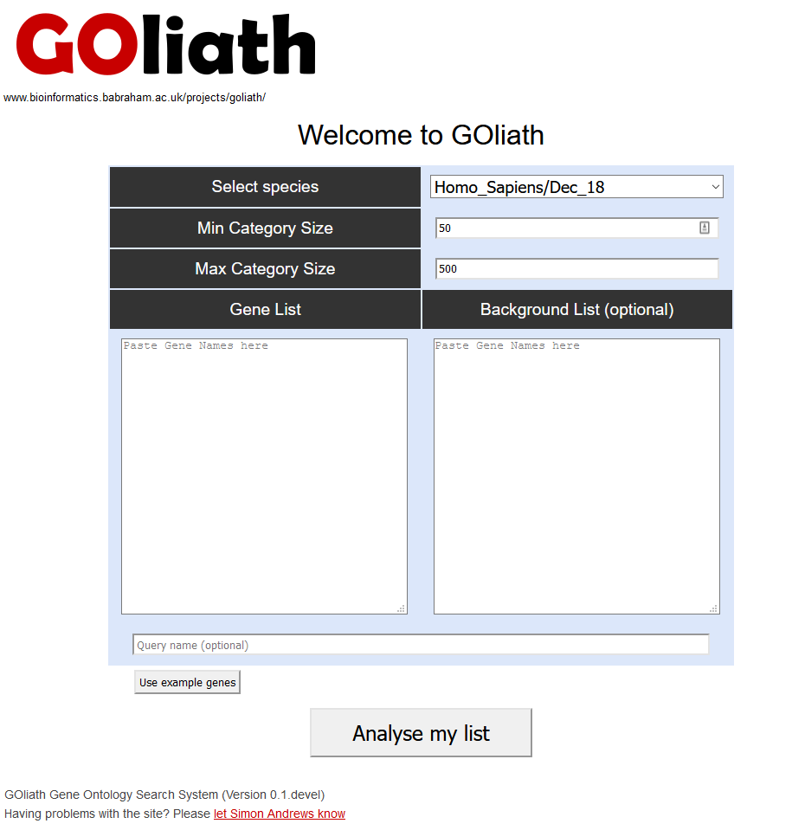
www.bioinformatics.babraham.ac.uk/goliath/

Slide 23
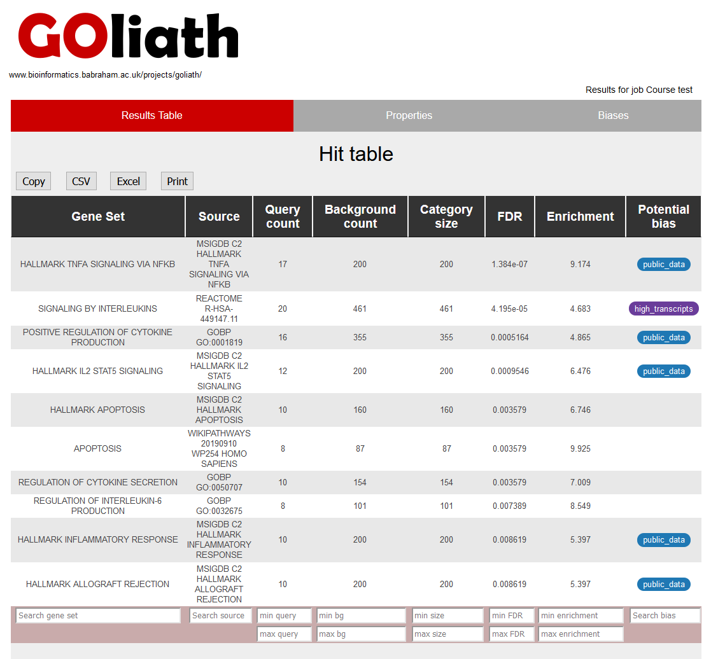
www.bioinformatics.babraham.ac.uk/goliath/

Slide 24
Hit Validation
Do my hits look different from non-hits in factors which should be unrelated
  Sequence composition
  Genomic position
  Gene Length
  Number of splice variants
  etc
If a bias exists then is this the actual link between genes? If not then can I fix this by improving my background list?

Slide 25
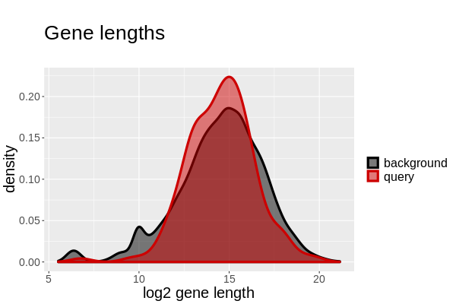
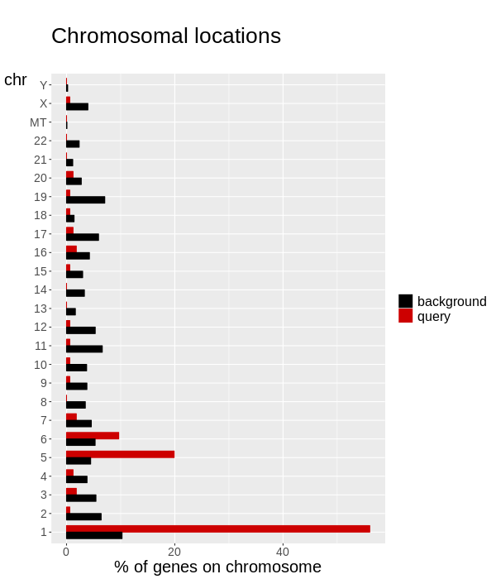
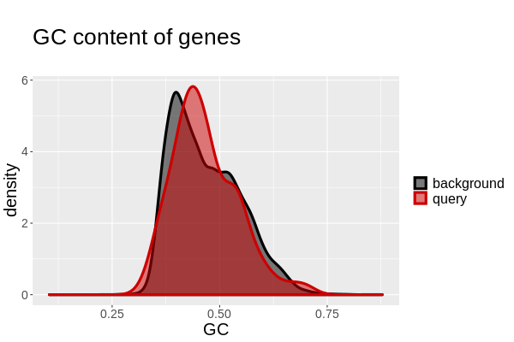
www.bioinformatics.babraham.ac.uk/goliath/

Slide 26
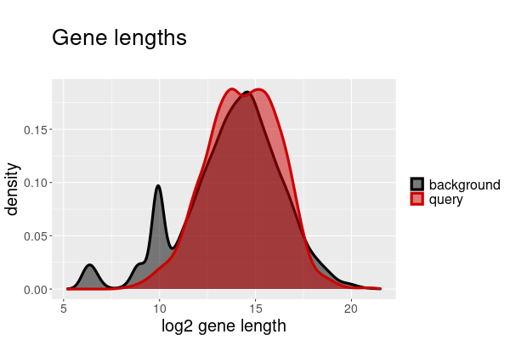
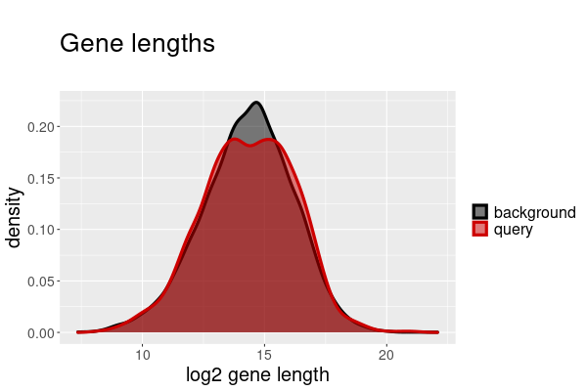
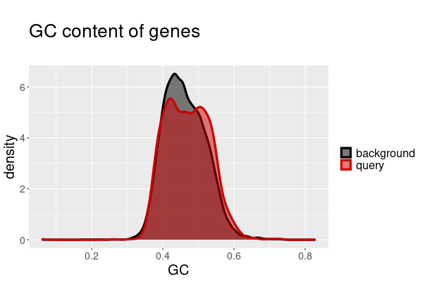
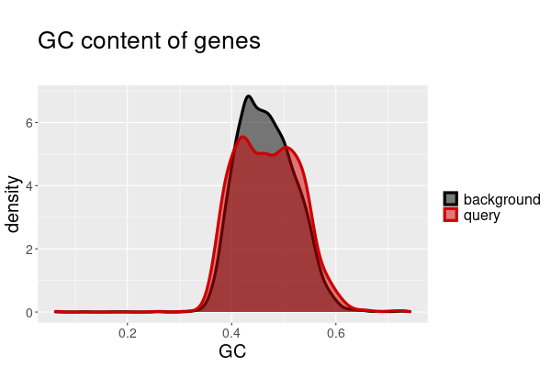
Custom backgrounds can make a difference

Slide 27
Custom backgrounds can make a difference
Top hits without correction
Top hits with correction
PLURINETWORK
POSITIVE REGULATION OF VASCULATURE DEVELOPMENT
POSITIVE REGULATION OF ANGIOGENESIS
HALLMARK E2F TARGETS
CHROMOSOME, CENTROMERIC REGION
DNA REPAIR
NEGATIVE REGULATION OF CELLULAR AMIDE METABOLISM
POSITIVE REGULATION OF ENDOTHELIAL CELL MIGRATION
NUCLEAR CHROMOSOME SEGREGATION
PID INTEGRIN1 PATHWAY
POSITIVE REGULATION OF VASCULATURE DEVELOPMENT
POSITIVE REGULATION OF ANGIOGENESIS
PID INTEGRIN1 PATHWAY
BETA1 INTEGRIN CELL SURFACE INTERACTIONS
INTEGRIN BINDING
ASSEMBLY OF COLLAGEN FIBRILS
NABA ECM REGULATORS
POSITIVE REGULATION OF ENDOTHELIAL CELL MIGRATION
RECEPTOR LIGAND ACTIVITY
STRIATED MUSCLE TISSUE DEVELOPMENT

Slide 28
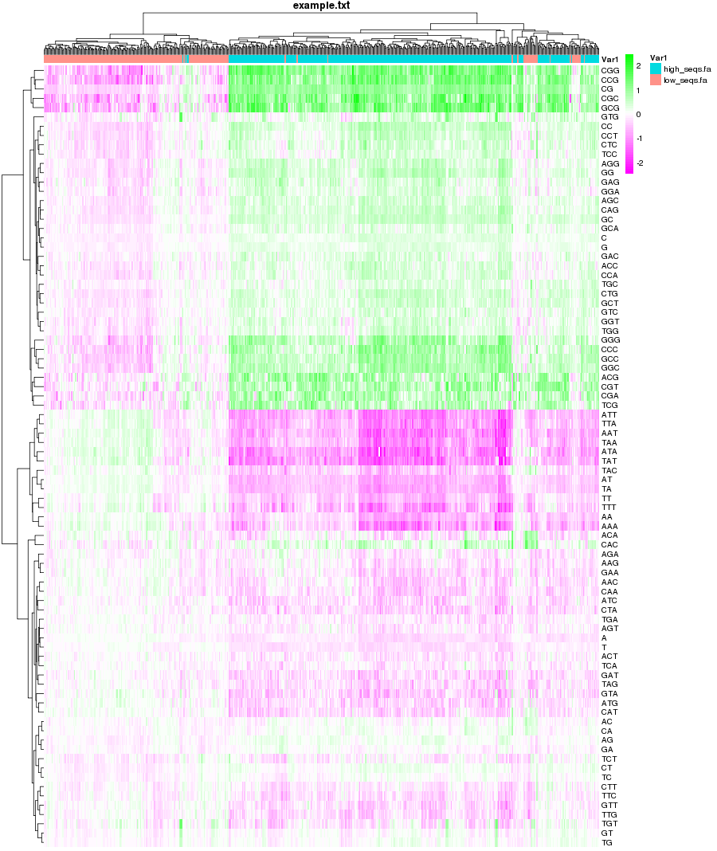
Check for unrelated factors
Compter
  Sequence kmer analysis
  Does composition explain my hits?
www.bioinformatics.babraham.ac.uk/projects/compter

Slide 29
Avoiding Biases
Create a custom background if applicable
  Should contain all genes which *could* have been in your hit list
  May be a compromise, but it's better than nothing
  Will limit which tools you can run
Filter your tested gene sets
  Remove large over powered sets, or sets which are too small to achieve significance (~50 to ~500 is generally about right)
  Will clean results and improve the stats for the good hits
  Check the hit gene sets for matches to known problematic sets

