Slide 1
An Introduction to Unix
v2023-01

Slide 2
Terminology and Distributions

Slide 3
Admin tools
Bundled Software
Support duration / cost

Slide 4
Most Popular Distributions
Ubuntu
Based on Debian
Originally aimed at desktop users
Friendly and well supported
Regular updates (some with long term support)
CentOS / Alma / Rocky
Free versions of the RedHat commercial distro
Mostly aimed at servers
Stable software and long term support
Used in many large environments

Slide 5
Types of Linux installation
Bare metal
Physical hardware
CD / DVD / USB / Network installation
Can be physically accessible (desktop) or remote (server / cluster)
Virtual Machine
Runs within another operating system
Portable / disposable
Install from ISO / Network
Cloud
Virtual machine on someone else's hardware
Amazon / Google are the main providers
Range of available hardware and OS images available

Slide 6
Connecting to Linux Installations

Slide 7
Connecting to a remote Linux installation
SSH – "Secure shell"
Encrypted connection
Text based interface
Authentication
Username + Password + 2 Factor Auth
Username + SSH key + 2 Factor Auth
OSX or Linux
Use the terminal program which comes with the OS
Windows
Git Bash (https://gitforwindows.org/)
PuTTY (https://www.putty.org/)

Slide 8
SSH + Password connection
ssh username@server.address
[Will be promoted for password]

Slide 9
SSH + Key connection
ssh -i [key_file.pem] username@server.address

Slide 10
Graphical Connections
Single application windows
X11
Sits on top of SSH
ssh -YC -i [key_file.pem] username@server.address
Virtual Desktop
VNC
Stand alone application or
Browser based desktop
https://www.xquartz.org/
https://sourceforge.net/projects/vcxsrv/

Slide 11
Exercise 1

Slide 12
Running programs in the BASH shell

Slide 13
Launching programs in Linux
Two major methods
Graphical
Command line
Graphical launches only work for graphical programs accessed through a graphical environment
Most data processing will be command line based, as will most remote access
Graphical programs can still be launched from the command line

Slide 14
Shells
A shell is a command line interpreter, used to launch software in Linux
There are many different shells available:
BASH
CSH
ZSH etc.
Most software will work the same in all shells
Some functions and automation are different between shells
We will use the most popular shell, BASH

Slide 15
What does a shell provide
Command line editing and construction tools (eg auto complete)
History
Job control
Configuration management (startup scripts)
Aliases
Automation
Scripting language
Variables, functions etc

Slide 16
Running programs in BASH
We will be using a graphical terminal running BASH
Right click and select "Open terminal here“
..or click the black square in the toolbar
..or, from Applications menu find Terminal Emulator

Slide 17
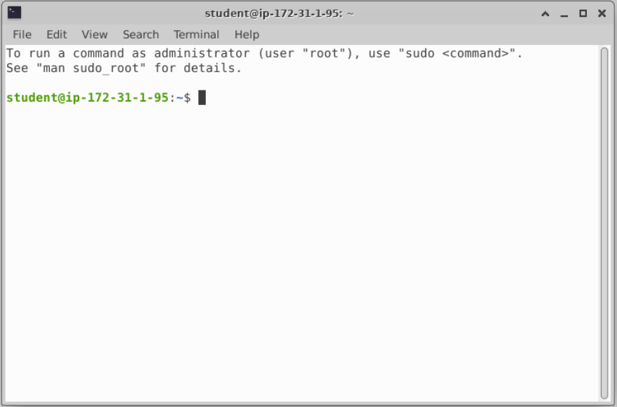

Slide 18
Running programs
Type the name of the program you want to run
Add on any options the program needs
Press return - the program will run
When the program ends control will return to the shell
Run the next program!

Slide 19
Running programs
student@ip1-2-3-4:~$ ls
Desktop Documents Downloads examples.desktop Music Pictures Public Templates Videos
student@ip1-2-3-4:~$
Command prompt - you can't enter a command unless you can see this
The command we're going to run (ls in this case, to list files)
The output of the command - just text in this case

Slide 20
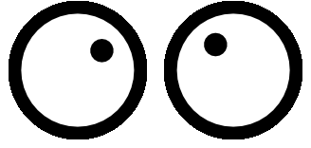
Running graphical programs
student@ip1-2-3-4:~$ xeyes
student@ip1-2-3-4:~$
Note that you can't enter another command
until you close the program you launched

Slide 21
The structure of a unix command
ls -ltd --reverse Downloads/ Desktop/ Documents/
Program
name
Switches
Data
(normally files)
Each option or section is separated by spaces. Options or files with spaces in must be put in quotes.

Slide 22
Command line switches
Change the behaviour of the program
Come in two flavours (each option usually has both types available)
Minus plus single letter (eg -x -c -z)
Can be combined (eg -xcz)
Two minuses plus a word (eg --extract --gzip)
Can't be combined
Some take an additional value, this can be an additional option, or use an = to separate (it's up to the program)
-f somfile.txt (specify a filename)
--width=30 (specify a value)

Slide 23
Manual pages
All core programs will have a manual page to document the options for the command
Manual pages are accessible using the man program followed by the program name you want to look up.
All manual pages have a common structure

Slide 24
Manual Pages (man cat)
CAT(1) User Commands CAT(1)
NAME
cat - concatenate files and print on the standard output
SYNOPSIS
cat [OPTION]... [FILE]...
DESCRIPTION
Concatenate FILE(s) to standard output.
With no FILE, or when FILE is -, read standard input.
-A, --show-all
equivalent to -vET
-n, --number
number all output lines
-T, --show-tabs
display TAB characters as ^I
--help display this help and exit
EXAMPLES
cat f - g
Output f's contents, then standard input, then g's contents.
cat Copy standard input to standard output.

Slide 25
Help Files
Non-core programs (including most analysis tools) won't have a manual page
They will often have their own internal help which looks very similar
You can usually access this using the --help (or -h) switch

Slide 26
Help Files (fastqc --help)
FastQC - A high throughput sequence QC analysis tool
SYNOPSIS
fastqc seqfile1 seqfile2 .. seqfileN
fastqc [-o output dir] [--(no)extract] [-f fastq|bam|sam]
[-c contaminant file] seqfile1 .. seqfileN
DESCRIPTION
FastQC reads a set of sequence files and produces from each one a quality
control report consisting of a number of different modules, each one of
which will help to identify a different potential type of problem in your
data.
The options for the program as as follows:
-h --help Print this help file and exit
-v --version Print the version of the program and exit
-o --outdir Create all output files in the specified output directory.
Please note that this directory must exist as the program
will not create it. If this option is not set then the
output file for each sequence file is created in the same
directory as the sequence file which was processed.

Slide 27
Exercise 2

Slide 28
Understanding Unix File Systems

Slide 29
Unix File Systems
Consists of a hierarchical set of directories (folders)
Each directory can contain files
No drive letters (drives can appear at arbitrary points in the file system)
No file extensions (you can add them, but they're not required)

Slide 30
A simple unix filesystem
/ (Always the top of the file system)
home/ (Directory containing all home directories)
anne/
simon/
Documents/ (All names are case sensitive)
test.txt (A file we want to work with)
/home/simon/Documents/test.txt
media/
myusb/ (A USB stick added to the system)

Slide 31
Creating and moving into directories
Every Unix session has a ‘working directory’ which is a folder where the shell looks for file paths
You can see your current working directory with pwd
Your initial working directory will be your home directory (eg /home/user)
You can change your working directory with cd [new working directory]
Running cd on its own takes you back home
You can create a new directory with mkdir [new directory name]

Slide 32
Changing the working directory
[andrewss@server ~]$ pwd
/home/andrewss
[andrewss@server ~]$ mkdir Simon
[andrewss@server ~]$ cd Simon
[andrewss@server Simon]$ pwd
/home/andrewss/Simon
[andrewss@server Simon]$ cd
[andrewss@server ~]$ pwd
/home/andrewss

Slide 33
Specifying file paths
Some shortcuts
~ (tilde, just left of the return key) - the current user's home directory
. (single dot) - the current directory
.. (double dot) - the directory immediately above the current directory

Slide 34
Specifying file paths
/home/
Simon/
Documents/
Course/
some_file.txt
Absolute paths from the top of the file system
/home/simon/Documents/Course/some_file.txt
Relative paths from your current director (home/simon/Course/)
Data/big_data.csv
Paths using the home shortcut
~/Documents/Course/some_file.txt

Slide 35
Command line completion
Most errors in commands are typing errors in either program names or file paths
Shells (ie BASH) can help with this by offering to complete path names for you
Command line completion is achieved by typing a partial path and then pressing the TAB key (to the left of Q)

Slide 36
Command line completion
List of files / folders:
Desktop
Documents
Downloads
Music
Public
Published
Templates
Videos
T [TAB] → Templates
P [TAB] → Publ
Do [TAB] → [beep]
Do [TAB] [TAB] → Documents Downloads
Doc [TAB] → Documents
You should ALWAYS use TAB completion to fill in paths for
locations which exist so you can't make typing mistakes
(it obviously won't work for output files though)

Slide 37
Wildcards
A quick way to be able to specify multiple related file paths
There are two main wildcards
* = Any number of any characters
? = One of any character
You can include them at any point in a file path and your shell will expand them before passing them on to the program
Multiple wildcards can be in the same path.
Command line completion won't work after the first wildcard

Slide 38
Wildcard examples
$ ls Monday/*txt
Monday/mon_1.txt Monday/mon_2.txt Monday/mon_3.txt Monday/mon_500.txt
$ ls Monday/mon_?.txt
Monday/mon_1.txt Monday/mon_2.txt Monday/mon_3.txt
$ ls */*txt
Friday/fri_1.txt Monday/mon_1.txt Monday/mon_3.txt Tuesday/tue_1.txt
Friday/fri_2.txt Monday/mon_2.txt Monday/mon_500.txt Tuesday/tue_2.txt
$ ls */*1.txt
Friday/fri_1.txt Monday/mon_1.txt Tuesday/tue_1.txt

Slide 39
The structure of a Unix command
D*
ls -ltd --reverse Downloads/ Desktop/ Documents/
Program
name
Switches
Data
(normally files)
Each option or section is separated by spaces. Options or files with spaces in must be put in quotes.

Slide 40
Manipulating files
You will spend a lot of time managing files on a Linux system.
Viewing files (normally text files)
Editing text files
Moving or renaming files
Copying files
Deleting files
Finding files

Slide 41
Viewing Files
Simplest solution
cat [file] Sends the entire contents of a file (or multiple files) to the screen.
Quick look
head or tail will look at the start/end of a file
head -10 [file]
tail -20 [file]
More scalable solution
less is a 'pager' program, sends output to the screen one page at a time
Return / j = move down one line
k = move up one line
Space = move down one page
b = go back one page
/[term] = search for [term] in the file
q = quit back to the command prompt
less -S (no wrapping)

Slide 42
Editing files
Lots of text editors exist, both graphical and command line
Many have special functionality for specific content (C, HTML etc)
nano is a simple command line editor which is always present

Slide 43
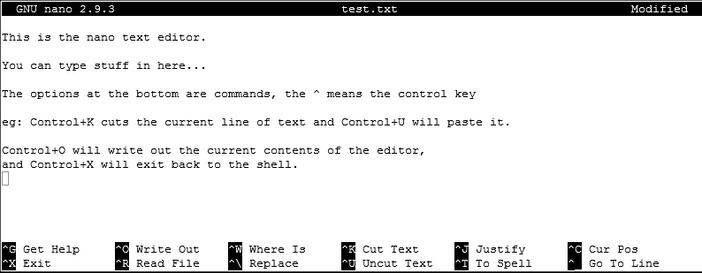
Using nano to edit text files
nano [filename] (edits if file exists, creates if it doesn't)

Slide 44
Moving / Renaming files
Uses the mv command for both (renaming is just moving from one name to another)
mv [file or directory] [new name/location]
If new name is a directory then the file is moved there with its existing name
Moving a directory moves all of its contents as well
Examples
mv old.txt new.txt
mv old.txt ../Saved/
mv old.txt ../Saved/new.txt
mv ../Saved/old.txt .

Slide 45
Copying files
Uses the cp command
cp [file] [new file]
Operates on a single file
Can copy directories using recursive copy (cp -r)
Examples
cp old.txt new.txt
cp old.txt ../Saved/
cp old.txt ../Saved/new.txt
cp ../Saved/old.txt .
cp -r ../Saved ./NewDir
cp -r ../Saved ./ExistingDir/ (only if ExistingDir exists)

Slide 46
Linking rather than copying
Copy duplicates the data in a file
Can be a problem with big data files
Links are a way to do 'virtual' copies. You can make the same file appear in more than one place.
Two types of link, hard links and soft (or symbolic) links
We will always use soft links as they're more flexible.

Slide 47
Creating symbolic links
Use the ln command with the -s modifier
Usage ln -s [from] [to]
Exactly the same structure as mv
When you list a link you can see where it points, but you can use it like a file
$ cat test.txt
This is a test file
$ ln -s test.txt test2.txt
$ ls -l test2.txt
lrwxrwxrwx 1 babraham babraham 8 Sep 11 16:27 test2.txt -> test.txt
$ cat test2.txt
This is a test file

Slide 48
Deleting files
Linux has no undo.
Deleting files has no recycle bin.
Linux will not ask you "are you sure"
Files can be deleted with the rm command
Directories (and all of their contents) can be deleted with rm -r
Examples
rm test_file.txt test_file2.txt
rm *.txt (be VERY careful using wildcards. Always run ls first to see what will go)
rm -r Old_directory/

Slide 49
Exercise 3

Slide 50
More advanced BASH usage

Slide 51
What we know already
How to run programs
How to modify the options for a program using switches
How to supply data to programs using file paths and wildcards

Slide 52
What else can we do
Record the output of programs
Check for errors in programs which are running
Link programs together into small pipelines
Automate the running of programs over batches of files
All of these are possible with some simple BASH scripting

Slide 53
Recording the output of programs
Three data streams exist for all Linux programs
STDIN (Standard Input - a way to send data into the program)
STDOUT (Standard Output - a way to send expected data out of the program)
STDERR (Standard Error - a way to send errors or warnings out of the program)
By default STDOUT and STDERR are connected to your shell, so when you see text coming from a program, it's coming from these streams.
STDOUT
STDIN
program
STDERR

Slide 54
Redirecting standard streams
You can redirect using arrows at the end of your command
> [file] Redirects STDOUT
2> [file] Redirects STDERR
2>&1 Sends STDERR into STDOUT
$ find . -print > file_list.txt 2> errors.txt
$ ls
Data Desktop Documents Downloads errors.txt examples.desktop file_list.txt Music Pictures Public Templates Videos
$ head file_list.txt
.
./Downloads
./Pictures
./Public
./Music
./.bash_logout
./.local
./.local/share
./.local/share/icc
./.local/share/icc/edid-33d524c378824a7b78c6c679234da6b1.icc

Slide 55
Throwing stuff away
Sometimes you want to be able to hide output
STDOUT - I just want to test whether something worked
STDERR - I want to hide progress / error messages
Linux defines a special file /dev/null which you can write to but just discards all data sent to it
might_fail > /dev/null
chatty_app 2> /dev/null

Slide 56
Linking programs together with pipes
Part of the original UNIX design was to have lots of small programs doing specific jobs, and then to link them together to perform more advanced tasks.
Pipes are designed to do this by connecting STDOUT from one program to STDIN on another

Slide 57
Linking programs together using pipes
Pipes are a mechanism to connect the STDOUT of one program to the STDIN of another. You can use them to build small pipelines
To create a pipe just use a pipe character | between programs
$ ls | head -2
Data
Desktop

Slide 58
Useful programs for pipes
Whilst you can theoretically use pipes to link any programs, there are some which are particularly useful, these are things like:
wc - to do word and line counting
grep - to do pattern searching
sort - to sort things
uniq - to deduplicate things
less - to read large amounts of output
zcat/gunzip/gzip - to do decompression or compression

Slide 59
Small example pipeline
Take a compressed fastq sequence file, extract from it all of the entries containing the telomere repeat sequence (TTAGGG) and count them
zcat file.fq.gz
| grep TTAGGGTTAGGG
| wc -l
$ zcat file.fq.gz | wc -l
179536960
$ zcat file.fq.gz | grep TTAGGGTTAGGG | wc -l
3925

Slide 60
Iterating over files
When processing data it is common to need to re-run the same command multiple times for different input/output files.
Some programs will support being provided with multiple input files, but many will not.
You can use the automation features of the BASH shell to automate the running of these types of programs

Slide 61
The BASH for loop
Simple looping construct
Loop over a set of files
Loop over a set of values
Creates a temporary environment variable which you can use when creating commands

Slide 62
Examples of for loops
for file in *txt
do
echo $file
grep .sam $file | wc -l
done
for value in {5,10,20,50}
do
run_simulation --iterations=$value > ${value}_iterations.log 2>&1
done
for value in {10..100}
do
run_simulation --iterations=$value > ${value}_iterations.log 2>&1
done

Slide 63
Job Control
By default you run one job at a time in a shell
Shells support multiple running jobs
States of job
Running - foreground (shell has the attention of the job)
Running - background (output goes to the shell but other jobs can run)
Suspended (job exists but is paused, consumes no CPU)
Running - disconnected (output is no longer attached to the shell)

Slide 64
Job Control
prog_to_run (starts in foreground)
prog_to_run & (starts in background)
Control of running jobs
jobs (lists the jobs in this shell)
Control + Z (suspends the current job)
bg (puts the current suspended job into the background
fg [number] (puts the selected job back in the foreground)

Slide 65
Job Control - nohup
nohup prog_to_run &
Merges STDOUT and STDERR
Disconnects from the terminal
Can't be killed when the terminal exits
Output appended to nohup.out
Can redirect with > logfile.txt

Slide 66
Exercise 4

